Slide 1
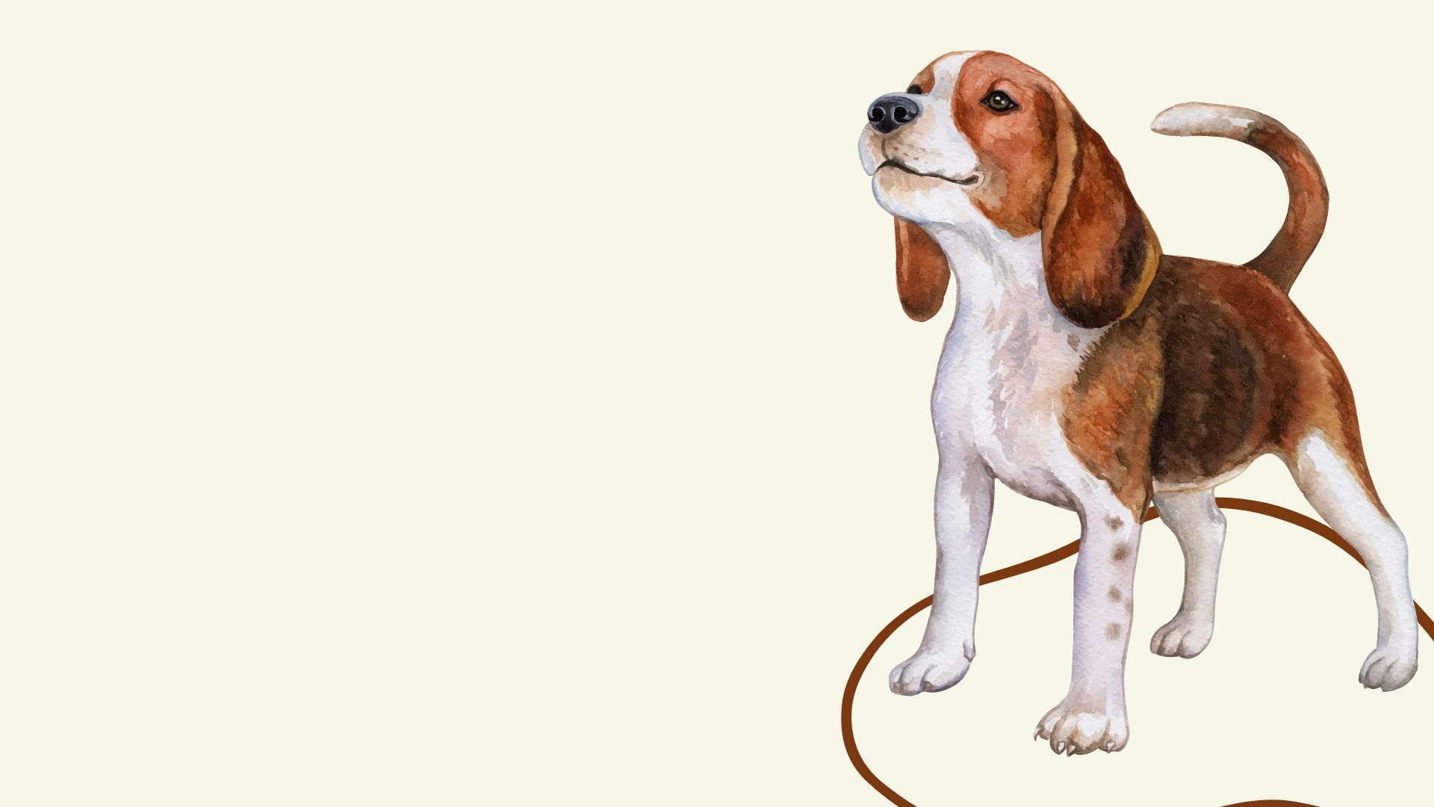
WAG WORKSHOPS
Directory Redesign
INFM 603
Project Presentation
Team 4
Scott Mobarry
Animesh Nandan
Sravya Lenka
Srikanth Parvathala

Slide 2
Description of our goals
The main goal of our project was to make the WAG WORKSHOPS Directory more convenient and maintainable for our client with a long term solution of data entry by business owners.
To make the website more user friendly and improve the user experiences of our clients, business owners, and pet owners by ensuring it is easy to navigate, accurately and interactively displays information to users about proximity based force-free certified services and is personalized to different types of stakeholders.
To fix the bugs already on the website.
Keep our client’s, business owners, and pet owners sensitive information stored on the website secure.

Slide 3
A brief demo of the final website
https://wagworkshopsdirectory.org/

Slide 4
Work performed amongst the team members
Task | Point of Contact
Test case review/ Team coordination | Scott
Design implementation/ Functionalities development/ Unit testing | Sravya/ Srikanth
Design planning/ Functional Testing | Animesh

Slide 5
The Most Interesting Part Of Implementation
One of the interesting functionalities we worked on was the Login and Registration on the website. It was a little tricky since we had to implement it from scratch on an existing website while keeping the already available data intact. We also added the registration information to the database so that the client can always keep track of the users registering. We had to come up with solutions to challenges we came across, step by step, which was a great learning experience.

Slide 6
List of Limitations
Google Maps API has restrictions with respect to billing
Usage of different tools are limited as we were working on the existing website
We developed all the functionalities based on desktop version and not on Mobile or tablet because of the time constraint

Slide 7
Reflection on the lessons that we learned by doing the project
Learning coordination within a team just like it happens at a workplace, we tried implementing a scrum model and had 2 sprints of 2 weeks to accomplish the task
Dealing with an actual client made us realize the importance of iterative feedback in our design and helped us develop a sense of responsibility to make sure we deliver on what we promised
Our technical prowess improved on the technology and applications we worked on

Slide 8
Thank You!

